Slide 1
Chomsky Hierarchy of Languages
&
Pushdown Automata (PDA)
Notes:
Cpt S 317: Spring 2009
School of EECS, WSU

Slide 2
Pumping Lemma
Discovered by Hehoshua Bar Hillel, Micha A Peries, and Eliahu Shamir in 1961.
It is called Pumping because we pump more stuff into the middle of the word, swelling it up without changing the front and back part of the string. Which is called lemma.
Helps us to prove that certain specific languages are not regular.

Slide 3
Pumping Lemma Theorem-1
Let L be any infinite regular language (that has infinite many words), defined over an alphabet ∑ then there exist three strings x, y and z belonging to ∑* (where y is not the null string) such that all the strings of the form xy^{n}z for n=1,2,3, … are the words in L.
If L is a regular language, then according to Kleene’s theorem, there exists an FA, say, F that accepts this language. Now F, by definition, must have finite no: of states while the language has infinitely many words. which shows that there is no restriction on the length of words in L, because if there were such restriction then the language would have finite many words.
Let w be a word in the language L, so that the length of word is greater than the number of states in F.
In this case the path generated by the word w, is such that it cannot visit a new state for each letter i.e. there is a circuit in this path.

Slide 4
Pumping Lemma Theorem-1
The word w, in this case, may be divided into three parts
The substring which generates the path from initial state to the state which is revisited first while reading the word w. This part can be called x and x can be a null string.
The substring which generates the circuit starting from the state which was lead by x. This part can be called as y which cannot be null string.
The substring which is the remaining part of the word after y, call this part as z. It may be noted that this part may be null string as the word may end after y or z part may itself be a circuit. Thus the word may be written as w = xyz where x,y and z are the strings, also y can’t be a null string.
Now this is obvious that, looping the circuit successively, the words xyyz, xyyyz, xyyyyz, … will also be accepted by this FA i.e. xy^{n}z, n=1,2,3, … will be words in L.

Slide 5
Example-1
Consider the language L = {a^{n}b^{n} where n=0,1,2,3,……}
According to Pumping Lemma there must be string x,y and z
such that all words of the form xy^{n}z are in L.
If w belongs to L it looks like aaa……aaaabbb…….bbb
it can be observed that for the word
w = (aaa)(aaaabbbb)(bbb) where x = aaa, y = aaaabbbb and
z = bbb
xyyz will contain as many number of a’s as there are b’s but this string will not belong to L because the substring ab can occur at the most once in the words of L, while the string xyyz contains the substring ab twice.
On the other hand if y-part consisting of only a’s or b’s, then xyyz will contain number of a’s different from number of b’s. This shows that pumping lemma does not hold and hence the language is not regular.

Slide 6
Palindrome
Consider the language PALINDROME and a word w = aba belonging to PALINDROME.
Decomposing w = xyz where x=a, y=b, z=a.
It can be observed that the strings of the form xy^{n}z for n=1,2,3, …, belong to PALINDROME.
Which shows that the pumping lemma holds for the language PALINDROME (which is non regular language).
To overcome this drawback of pumping lemma, a revised version of pumping lemma has been introduced.

Slide 7



Pigeonhole Principle
pigeons
pigeonholes

Slide 8



The Pigeonhole Principle
pigeons
There is a pigeonhole
with at least 2 pigeons
pigeonholes
...........

Slide 9
Pumping Lemma Theorem-2
Let L be an infinite language accepted by a finite automaton with N states, then for all words w in L that have length more than N, there are strings x,y and z (y being non-null string) and length(x) + length(y) does not exceed N s.t. w = xyz and all strings of the form xy^{n}z are in L for n = 1,2,3, …

Slide 10



Proof
Let w = a₁a₂a₃………………a_{m} m>n
After Reading W q₀q₁q₂…q_{i}q_{j}………..q_{m} i<j
_{q0}
_{q i = qj}
_{qm}

Slide 11
Pumping Lemma Theorem-2
Suppose FA has n states
a₁a₂a₃……a_{i}..a_{j+1}…………a_{m} will be accepted.
a₁a₂a₃……a_{i} (a_{i+1}……a_{j})a_{j+1}…………a_{m}
a₁a₂a₃……a_{i} (a_{i+1}……a_{j})^{i}a_{j+1}…………a_{m}
Therefore it can be written as
w=xy^{i}z Ɛ L for all i>=0

Slide 12
Example-1
Let the PALINDROME be a regular language and is
accepted by an FA of 78 states. Consider the word
w = a⁸⁵ba⁸⁵.
Decompose w as xyz, where x,y and z are all strings belonging to ∑* while y is non-null string, s.t.
length(x) + length(y) <= 78, which shows that the substring xy is consisting of a’s and xyyz will become a^{more than 85}ba⁸⁵ which is not in PALINDROME. Hence pumping lemma version II is not satisfied for the
language PALINDROME. Thus pumping lemma version II can’t be satisfied by any non regular language.

Slide 13
Example-2
Consider the language PRIME, of strings defined over ∑= {a}, as {a^{p} : p is prime}, i.e.PRIME = {aa, aaa, aaaaa, aaaaaaa, …}
To prove this language to be nonregular, suppose contrary, i.e. PRIME is a regular language, then there exists an FA accepts the language PRIME.
Let the number of states of this machine be 345 and choose a word w from PRIME with length more than 345, say, 347 i.e. the word w = a³⁴⁷
Since this language is supposed to be regular, therefore according to pumping lemma xy^{n}z, for n = 1,2,3,… are all in PRIME.

Slide 14
Example-2 (Continued….)
Consider n=348
then xy^{n}z = xy³⁴⁸z = xy³⁴⁷yz.
Since x,y and z consist of a’s, so the order of x, y, z does not matter i.e. xy³⁴⁷yz = xyzy³⁴⁷ = a³⁴⁷ y³⁴⁷, y being non-null string and consisting of a’s it can be written y = a^{m}, m=1,2,3,…,345.
Thus xy³⁴⁸z = a³⁴⁷ (a^{m})³⁴⁷ = a^{347(m+1)}
Now the number 347(m+1) will not remain PRIME for m = 1,2,3, …, 345. Which shows that the string xy³⁴⁸z is not in PRIME.
Hence pumping lemma version II is not satisfied by the language PRIME. Thus PRIME is not regular.

Slide 15
Chomsky Hierarchy of Grammar
Noam Chomsky studied grammars as potential models for natural languages. He classified grammars according to these four types:
Type-0 Grammar
(Unrestricted)
Type-1 Grammar
(Context Sensitive)
Type-2 Grammar
(Context Free)
Type-3 Grammar
(Regular)
Notes:
Cpt S 317: Spring 2009
School of EECS, WSU

Slide 16
Type-3 Grammar (Regular)
To Generate Regular languages
A right regular grammar (also called right linear grammar) is a formal grammar
G=(N, Σ, P, S) such that all the production rules in P are of one of the following forms:
B → a - where B is a non-terminal in N and a is a terminal in Σ
B → aC - where B and C are in N and a is in Σ
B → ε - where B is in N and ε denotes the empty string, i.e. the string of length 0.
Notes:
Cpt S 317: Spring 2009
School of EECS, WSU

Slide 17
Type-2 Grammar (CFG)
A left regular grammar (also called left linear grammar), all rules obey the forms
A → a - where A is a non-terminal in N and a is a terminal in Σ
A → Ba - where A and B are in N and a is in Σ
A → ε - where A is in N and ε is the empty string.
An example of a right regular grammar G with N = {S, A},
Σ = {a, b, c}, P consists of the following rules
S → aS
S → bA
A → ε
A → cA
This grammar describes the same language as the regular expression a*bc*.
Notes:
Cpt S 317: Spring 2009
School of EECS, WSU

Slide 18
Type-2 Grammar
In formal language theory, a context-free grammar (CFG) is a formal grammar
G = (N, Σ, P, S) in which every production rule is of the form V → w
where V is a single nonterminal symbol, and w is a string of terminals and/or nonterminals (w can be empty).
The languages generated by context-free grammars are known as the context-free languages.
Notes:
Cpt S 317: Spring 2009
School of EECS, WSU

Slide 19
Type-2 Grammar
Here is an example of a context free grammar of parenthesis matching. There are two terminal symbols "(" and ")" and one nonterminal symbol S.
The production rules are
S → SS
S → (S)
S → ()
Notes:
Cpt S 317: Spring 2009
School of EECS, WSU

Slide 20
Type-1 Grammar (CSG)
A context-sensitive grammar (CSG) is a formal grammar in which the left-hand sides and right-hand sides of any production rules may be surrounded by a context of terminal and nonterminal symbols.
A formal grammar G = (N, Σ, P, S) (this is the same as G = (V, T, P, S), where N/V is the Non-terminal Variable, and Σ/T is the Terminal) is context-sensitive if all rules in P are of the form αAβ → αγβ
where A ∈ N (i.e., A is a single nonterminal), α,β ∈ (N U Σ)* (i.e., α and β are strings of nonterminals and terminals) and γ ∈ (N U Σ)+ (i.e., γ is a nonempty string of nonterminals and terminals).
Notes:
Cpt S 317: Spring 2009
School of EECS, WSU

Slide 21
Type-1 Grammar
Some definitions also add that for any production rule of the form u → v of a context-sensitive grammar, it shall be true that |u|≤|v|. Here |u| and |v| denote the length of the strings respectively.
In addition, a rule of the form S → λ provided S does not appear on the right side of any rule.
where λ represents the empty string is permitted.
Notes:
Cpt S 317: Spring 2009
School of EECS, WSU

Slide 22
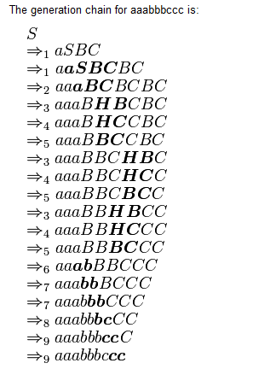
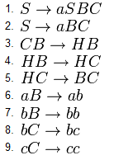
Type-1 Grammar
Notes:
Cpt S 317: Spring 2009
School of EECS, WSU

Slide 23
The Chomsky Hierarchy and the Block Diagram of a Compiler
Type3
Type2
tokens
Int.
code
Object
language
program
Source
language
program
tree
Scanner
Parser
Inter-
mediate
Code
Generator
Optimizer
Code
Generator
Type1
Symbol
Table
Manager
Error
Handler
Error
messages
Symbol Table

Slide 24
Type-0 Grammar (Unrestricted)
Type-0 grammars (unrestricted grammar) include all formal grammars. They generate exactly all languages that can be recognized by a Turing machine. These languages are also known as the recursively enumerable languages.
A recursively enumerable language is a formal language for which there exists a Turing machine (or other computable function) which will enumerate all valid strings of the language.
Notes:
Cpt S 317: Spring 2009
School of EECS, WSU

Slide 25
Type-0 Grammar
An unrestricted grammar is a formal grammar G = (N, Σ, P, S) in which every production rule is of the form α → β
Where α, β are strings of symbols in NUΣ and α is not the empty string. SϵN is specially designated as start symbol.
There are no real restrictions on the types of production rules that unrestricted grammars can have.
Notes:
Cpt S 317: Spring 2009
School of EECS, WSU

Slide 26
PDA - the automata for CFLs
What is?
  FA to Reg Lang, PDA is to CFL
PDA == [ ε -NFA + “a stack” ]
Why a stack?
Input
string
ε-NFA
Accept/reject
A stack filled with “stack symbols”
Notes:
Cpt S 317: Spring 2009
School of EECS, WSU

Slide 27
Pushdown Automata - Definition
A PDA P := ( Q,∑,Γ, δ,q₀,Z₀,F ):
  Q: states of the ε-NFA
  ∑: input alphabet
  Γ : stack symbols
  δ: transition function
  q₀: start state
  Z₀: Initial stack top symbol
  F: Final/accepting states
Notes:
Cpt S 317: Spring 2009
School of EECS, WSU

Slide 28
δ : The Transition Function
old state
Stack top
input symb.
new state(s)
new Stack top(s)
δ : Q x Γ x ∑ => Q x Γ
Non-determinism
δ(q,a,X) = {(p,Y), …}
  state transition from q to p
  a is the next input symbol
  X is the current stack top symbol
  Y is the replacement for X;
  it is in Γ* (a string of stack symbols)
    Set Y = ε for: Pop(X)
    If Y=X:stack top is unchanged
    If Y=Z₁Z₂…Z_{k}: X is popped and is replaced by Y in reverse order (i.e., Z₁ will be the new stack top)
a
X
Y
q
p
 | Y = ? | Action
i) | Y=ε | Pop(X)
ii) | Y=X | Pop(X) Push(X)
iii) | Y=Z₁Z₂..Z_{k} | Pop(X) Push(Z_{k}) Push(Z_{k-1}) … Push(Z₂) Push(Z₁)
Notes:
Cpt S 317: Spring 2009
School of EECS, WSU

Slide 29
Example-1 (Acceptance by Empty Store)
Top Plates | State | 0 | 1 | c
Blue | q₁ | Add a Blue Plate and remains in state q₁ | Add a Green Plate and remains in state q₁ | Goto q₂
 | q₂ | Remove a Blue Plate and remains in state q₂ | ------------------------- | -------------------
Green | q₁ | Add a Blue Plate and remains in state q₁ | Add a Green Plate and remains in state q₁ | Goto q₂
 | q₂ | ---------------------------------------- | Remove a Blue Plate and remains in state q₂ | ---------------------------
Red | q₁ | Add a Blue Plate and remains in state q₁ | Add a Green Plate and remains in state q₁ | Goto q₂
 | q₂ | Without waiting for any input symbol remove Red Plate.
Notes:
Cpt S 317: Spring 2009
School of EECS, WSU

Slide 30
Example-1 (Acceptance by Empty Store)
Initial state of the PDA:
Stack
top
q₁
R
P=( Q,∑, Γ, δ,q₁,R, ɸ ) Hint: B for 0 and G for 1.
Q={ q_{1,} q₂ } ∑ ={0,1,c}
Γ={ R,B,G} q₁ is initial state and R is at top of the Stack.
δ : mapping are given Below
δ(q₁,0, R)={(q₁,BR)} → Already have a Blue Plate
δ(q₁,1, R)={(q₁,GR)}
δ(q₁,c, R)={(q₂,R)}
δ(q₁,0, B)={(q₁,BB)}
δ(q₁,1, B)={(q₁,GB)}
δ(q₁,c, B)={(q₂,B)}
δ(q₁,0, G)={(q₁,BG)}
δ(q₁,1, G)={(q₁,GG)}
δ(q₁,c, G)={(q₂,G)}
δ(q₂, 0, B)={(q₂, ε)}
δ(q₂, 1, G)={(q₂, ε)}
δ(q₂ , ε , R)={(q₂, ε)}
Pop stack for
matching symbols
0, R/BR
1, R/GR
0, B/BB
1, B/GB
0, G/BG
1, G/GG
0, B/ ε
1, G/ ε
ε, R/ ε
c, R/R
c, B/B
c, G/G
q₁
q₂
ε, R/R
Switch to
popping mode
Grow stack
Notes:
Cpt S 317: Spring 2009
School of EECS, WSU

Slide 31

Example-1 (Acceptance by Empty Store)
0, R/BR
1, R/GR
0, B/BB
1, B/GB
0, G/BG
1, G/GG
Pop stack for
matching symbols
Input | 0 1 1 c 1 1 0
State | q₁ q₁ q₁ q₁ q₂ q₂ q₂
Stack Initially
0, B/ ε
1, G/ ε
ε, R/ ε
c, R/R
c, B/B
c, G/G
q₁
q₂
ε, R/R
Switch to
popping mode
Grow stack
Note: Whole input has been Read and Stack is empty, it means string is accepted. It is Called Acceptance by Empty store.
Notes:
Cpt S 317: Spring 2009
School of EECS, WSU

Slide 32
Example-2 (Acceptance by Final State)
Let L_{wwr} = {ww^{R} | w is in {0,1}* }
CFG for L_{wwr} : S==> 0S0 | 1S1 | ε
PDA for L_{wwr} :
P := ( Q,∑, Γ, δ,q₀,Z₀,F )
= ( {q₀, q₁, q₂},{0,1},{0,1,Z₀},δ,q₀,Z₀,{q₂})
Notes:
Cpt S 317: Spring 2009
School of EECS, WSU

Slide 33
PDA for L_{wwr}
Initial state of the PDA:
q₀
Stack
top
Z₀
δ(q₀,0, Z₀)={(q₀,0Z₀)}
δ(q₀,1, Z₀)={(q₀,1Z₀)}
δ(q₀,0, 0)={(q₀,00)}
δ(q₀,0, 1)={(q₀,01)}
δ(q₀,1, 0)={(q₀,10)}
δ(q₀,1, 1)={(q₀,11)}
δ(q₀, ε, 0)={(q₁, 0)}
δ(q₀, ε, 1)={(q₁, 1)}
δ(q₀, ε, Z₀)={(q₁, Z₀)}
δ(q₁,0, 0)={(q₁, ε)}
δ(q₁,1, 1)={(q₁, ε)}
δ(q₁, ε, Z₀)={(q₂, Z₀)}
First symbol push on stack
Grow the stack by pushing
new symbols on top of old
(w-part)
Switch to popping mode
(boundary between w and w^{R})
Shrink the stack by popping matching
symbols (w^{R}-part)
Enter acceptance state
Notes:
Cpt S 317: Spring 2009
School of EECS, WSU

Slide 34
PDA as a state diagram
δ(q_{i},a, X)={(q_{j},Y)}
Next
input
symbol
Current
stack
top
Stack
Top
Replacement
(w/ string Y)
Current
state
a, X / Y
Next
state
q_{i}
q_{j}
Notes:
Cpt S 317: Spring 2009
School of EECS, WSU

Slide 35
PDA for L_{wwr}: Transition Diagram
Grow stack
∑ = {0, 1}
= {Z₀, 0, 1}
Q = {q₀,q₁,q₂}
0, Z₀/0Z₀
1, Z₀/1Z₀
0, 0/00
0, 1/01
1, 0/10
1, 1/11
Pop stack for
matching symbols
0, 0/ ε
1, 1/ ε
ε, Z₀/Z₀
q₀
q₁
q₂
ε, Z₀/Z₀
ε, 0/0
ε, 1/1
ε, Z₀/Z₀
Go to acceptance
Switch to
popping mode
This would be a non-deterministic PDA
Notes:
Cpt S 317: Spring 2009
School of EECS, WSU

Slide 36
How does the PDA for L_{wwr} work on input “1111”?
0, Z₀/0Z₀
1, Z₀/1Z₀
0, 0/00
0, 1/01
1, 0/10
1, 1/11
Input | 1 | 1 | ε | 1 | 1 | ε
State | q₀ | q₀ | q₀ | q₁ | q₁ | q₁
Stack Initially Z₀ | 1 Z₀ | 1 1 Z₀ | 1 1 Z₀ | 1 Z₀ | Z₀ | You reached at Final state q₂ and Stack top symbol is Z₀
0, 0/ ε
1, 1/ ε
q₀
q₁
q₂
ε, Z₀/Z₀
ε, 0/0
ε, 1/1
ε, Z₀/Z₀
ε, Z₀/Z₀
(q₀,1111,Z₀)
(q₁, ε,Z₀)
(q₀,111,1Z₀)
(q₂, ε,Z₀)
(q₀,11,11Z₀)
Acceptance by
final state:
= empty input
AND
final state
(q₁,11,11Z₀)
(q₁,1,1Z₀)
Notes:
Cpt S 317: Spring 2009
School of EECS, WSU

Slide 37
How does the PDA for L_{wwr} work on input “0100”?
0, Z₀/0Z₀
1, Z₀/1Z₀
0, 0/00
0, 1/01
1, 0/10
1, 1/11
0, 0/ ε
1, 1/ ε
Input | 0 | 1 | ε | 0 | 0
State | q₀ | q₀ | q₀ | q₁
Stack Initially Z₀ | 0 Z₀ | 1 0 Z₀ | 1 0 Z₀ | Here input symbol is 0 and stack top symbol is 1, so no mapping in the form 0,1 / ε is defined. PDA will halt at q₁ and final state can not be obtained it means string is invalid.
q₀
q₁
q₂
ε, Z₀/Z₀
ε, 0/0
ε, 1/1
ε, Z₀/Z₀
ε, Z₀/Z₀
Notes:
Cpt S 317: Spring 2009
School of EECS, WSU

Slide 38
Example 3: language of balanced parenthesis
δ(q₀, (, Z₀)={(q₀,( Z₀)}
δ(q₀, (, ( )={(q₀, (( )}
δ(q₀, ), ( )={(q₀, ε )}
δ(q₀, ε, Z₀)={(q₁, Z₀)}
∑ = { (, ) }
= {Z₀, ( }
Q = {q₀,q₁}
(,Z₀ / ( Z₀
(,( / ( (
), ( / ε
start
ε,Z₀/ Z₀
q₀
q₁
How PDA Works on input “(()())”
ε,Z₀/ Z₀
Input | ( | ( | ) | ( | ) | ) | ε
State | q₀ | q₀ | q₀ | q₀ | q₀ | q₀ | q₀
Stack Initially Z₀ | ( Z₀ | ( ( Z₀ | ( Z₀ | ( ( Z₀ | ( Z₀ | Z₀ | With ε,Z₀/ Z_{0,} from q_{0,} You reached at final state q_{1.} It means string is valid string.
Notes:
Cpt S 317: Spring 2009
School of EECS, WSU

Slide 39
Example 3: language of balanced parenthesis
δ(q₀, (, Z₀)={(q₀,( Z₀)}
δ(q₀, (, ( )={(q₀, (( )}
δ(q₀, ), ( )={(q₀, ε )}
δ(q₀, ε, Z₀)={(q₁, Z₀)}
∑ = { (, ) }
= {Z₀, ( }
Q = {q₀,q₁}
(,Z₀ / ( Z₀
(,( / ( (
), ( / ε
start
ε,Z₀/ Z₀
q₀
q₁
How PDA Works on input “(()))”
ε,Z₀/ Z₀
Input | ( | ( | ) | ) | )
State | q₀ | q₀ | q₀ | q₀ | q₀
Stack Initially Z₀ | ( Z₀ | ( ( Z₀ | ( Z₀ | Z₀ | Here input symbol is ) and stack top symbol is Z₀, but no mapping with input ) and stack top symbol Z₀ is defined. PDA halts at q₀ and final state can’t be obtained. String is invalid.
Notes:
Cpt S 317: Spring 2009
School of EECS, WSU

Slide 40
PDA’s Instantaneous Description (ID)
A PDA has a configuration at any given instance: (q,w,y)
  q - current state
  w - remainder of the input (i.e., unconsumed part)
  y - current stack contents as a string from top to bottom of stack
If δ(q,a, X)={(p, A)} is a transition, then the following are also true:
  (q, a, X ) |--- (p,ε,A)
  (q, aw, XB ) |--- (p,w,AB)
|--- sign is called a “turnstile notation” and represents one move e.g: ID₀|--ID₁|--ID₂|-- ........|--ID_{n}
|---* sign represents a sequence of moves
e.g: ID₀ |--* ID_{n}
Notes:
Cpt S 317: Spring 2009
School of EECS, WSU

Slide 41
Acceptance by…
There are two types of PDAs that one can design:
those that accept by final state or by empty stack
PDAs that accept by final state:
  For a PDA P, the language accepted by P, denoted by L(P) by final state, is:
    {w | (q₀,w,Z₀) |---* (q,ε, A) }, s.t., q ∈ F
Here Ɛ means remaining input portion is empty
and A Means stack may contain some symbols.
PDAs that accept by empty stack:
  For a PDA P, the language accepted by P, denoted by N(P) or Null(P) by empty stack, is:
    {w | (q₀,w,Z₀) |---* (q, ε, ε) }, for any q ∈ Q.
Here Ɛ means remaining input portion is empty and Ɛ means stack is also empty.
Checklist:
- input exhausted?
- in a final state?
Q) Does a PDA that accepts by empty stack
need any final state specified in the design?
Checklist:
- input exhausted?
- is the stack empty?
Notes:
Cpt S 317: Spring 2009
School of EECS, WSU

Slide 42
Example: L of balanced parenthesis
An equivalent PDA that
accepts by empty stack
PDA that accepts by final state
(,Z₀ / ( Z₀
(, ( / ( (
), ( / ε
ε,Z₀ / ε
P_{F}:
P_{N}:
(,Z₀ / ( Z₀
(,( / ( (
), ( / ε
start
ε,Z₀/ Z₀
start
q₀
q₁
q₀
ε,Z₀/ Z₀
ε,Z₀/ Z₀
How will these two PDAs work on the input: ( ( ( ) ) ( ) ) ( )

Slide 43
Example: Matching parenthesis “(” “)”
P_{N}: ( {q₀}, {(,)}, {Z₀,Z₁}, δ_{N}, q₀, Z₀ )
δ_{N}: δ_{N}(q₀,(,Z₀) = { (q₀,Z₁Z₀) }
δ_{N}(q₀,(,Z₁) = { (q₀, Z₁Z₁) }
δ_{N}(q₀,),Z₁) = { (q₀, ε) }
δ_{N}(q₀, ε,Z₀) = { (q₀, ε) }
P_{f}: ( {p₀,q₀ ,p_{f}}, {(,)}, {X₀,Z₀,Z₁}, δ_{f}, p₀, X_{0 ,} p_{f})
δ_{f}: δ_{f}(p₀, ε,X₀) = { (q₀,Z₀ X₀) }
δ_{f}(q₀,(,Z₀) = { (q₀,Z₁ Z₀) }
δ_{f}(q₀,(,Z₁) = { (q₀, Z₁Z₁) }
δ_{f}(q₀,),Z₁) = { (q₀, ε) }
δ_{f}(q₀, ε,Z₀) = { (q₀, ε) }
δ_{f}(p₀, ε,X₀) = { (p_{f}, X₀ ) }
(,Z₀ /Z₁Z₀
(,Z₁ /Z₁Z₁
),Z₁ / ε
ε,Z₀ / ε
(,Z₀/Z₁Z₀
(,Z₁/Z₁Z₁
),Z₁/ ε
ε ,Z₀/ ε
start
start
ε,X₀/Z₀X₀
ε,X₀/ X₀
q₀
p₀
q₀
p_{f}
Accept by empty stack
Accept by final state
Notes:
Cpt S 317: Spring 2009
School of EECS, WSU

Slide 44
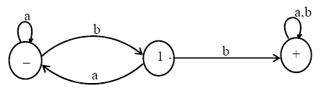
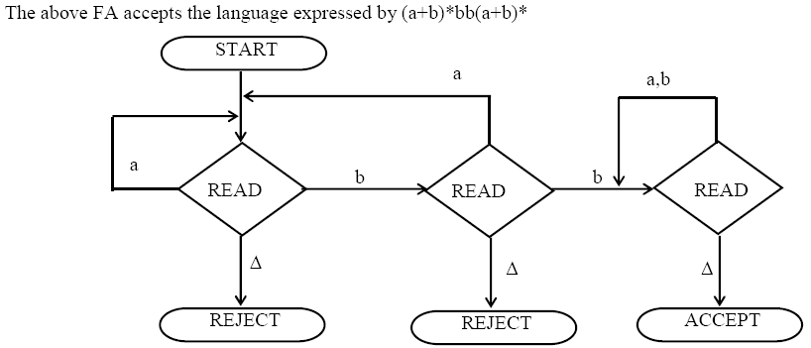
FA and PDA
Notes:
Cpt S 317: Spring 2009
School of EECS, WSU

Slide 45
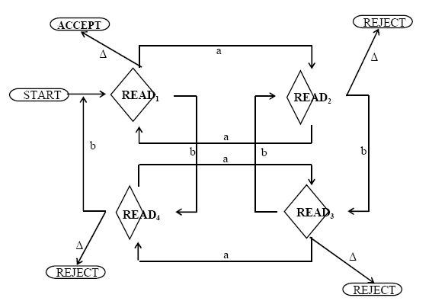
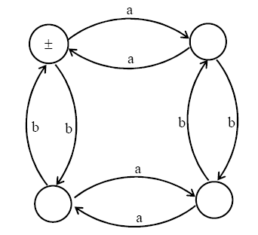
FA and PDA
Consider the following Even-Even language
Corresponding PDA
Notes:
Cpt S 317: Spring 2009
School of EECS, WSU

Slide 46
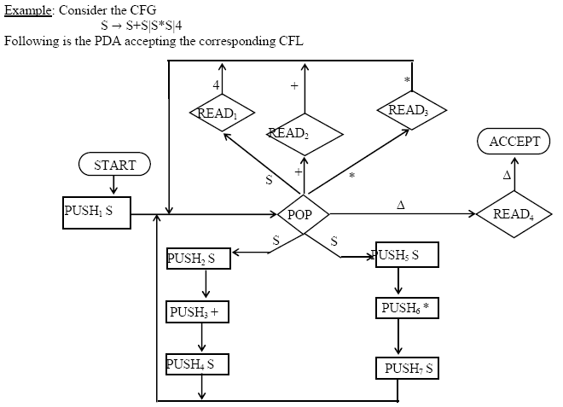
CFG and PDA
Notes:
Cpt S 317: Spring 2009
School of EECS, WSU

Slide 47
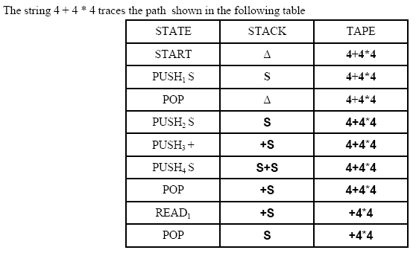
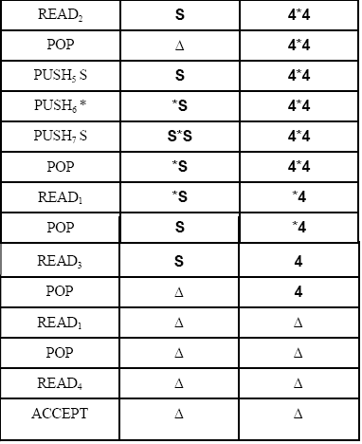
CFG and PDA
Notes:
Cpt S 317: Spring 2009
School of EECS, WSU

Slide 48

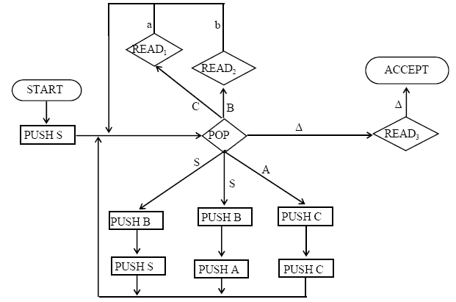
CFG and PDA
Notes:
Cpt S 317: Spring 2009
School of EECS, WSU

Slide 49
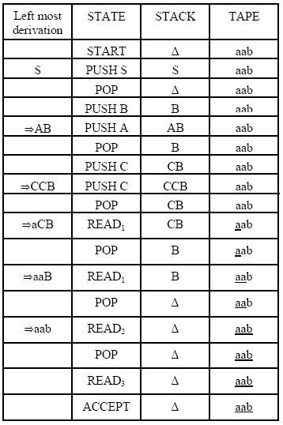
CFG and PDA
Notes:
Cpt S 317: Spring 2009
School of EECS, WSU

Slide 50
Deterministic PDA: Definition
A PDA is deterministic if and only
  1) δ(q,a,X) has at most one member for any a ∈ ∑ U {ε}
  means choice should be unique
  2) If δ(q,a,X) is non-empty for some a∈∑, then δ(q, ε,X) must be empty.
means if you allow for true input “a” then you will not allow for ε move
Notes:
Cpt S 317: Spring 2009
School of EECS, WSU

Slide 51
D-PDA for L_{wcwr} = {wcw^{R} | c is some special symbol not in w}
Example shows that: Nondeterministic PDAs ≠ D-PDAs
Note:
all transitions have become deterministic
Grow stack
Pop stack for
matching symbols
0, Z₀/0Z₀
1, Z₀/1Z₀
0, 0/00
0, 1/01
1, 0/10
1, 1/11
0, 0/ ε
1, 1/ ε
q₀
q₁
q₂
c, Z₀/Z₀
c, 0/0
c, 1/1
ε, Z₀/Z₀
Accepts by
final state
Switch to
popping mode
Notes:
Cpt S 317: Spring 2009
School of EECS, WSU

